Slide 1
Normalizations

Slide 2

Notations
$x∈R^{N×C×W×H}$, where
N is the batch size
C is numer of channels
W is width
H is heigth

Slide 3
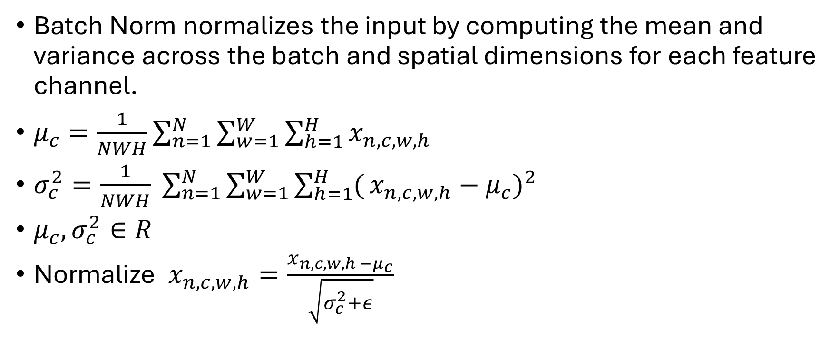
Batch Normalization - Training
Batch Norm normalizes the input by computing the mean and variance across the batch and spatial dimensions for each feature channel.
$μ_{c}=\frac{1}{NWH}\sum_{n=1}^{N}{\sum_{w=1}^{W}{\sum_{h=1}^{H}{x_{n,c,w,h}}}}$
$σ_{c}^{2}=\frac{1}{NWH} \sum_{n=1}^{N}{\sum_{w=1}^{W}{\sum_{h=1}^{H}{(}}}{x_{n,c,w,h}−μ_{c})}^{2}$
$μ_{c}, σ_{c}^{2}∈R$
Normalize $x_{n,c,w,h}=\frac{x_{n,c,w,h −μ_{c}}}{\sqrt{σ_{c}^{2}+ε}}$

Slide 4
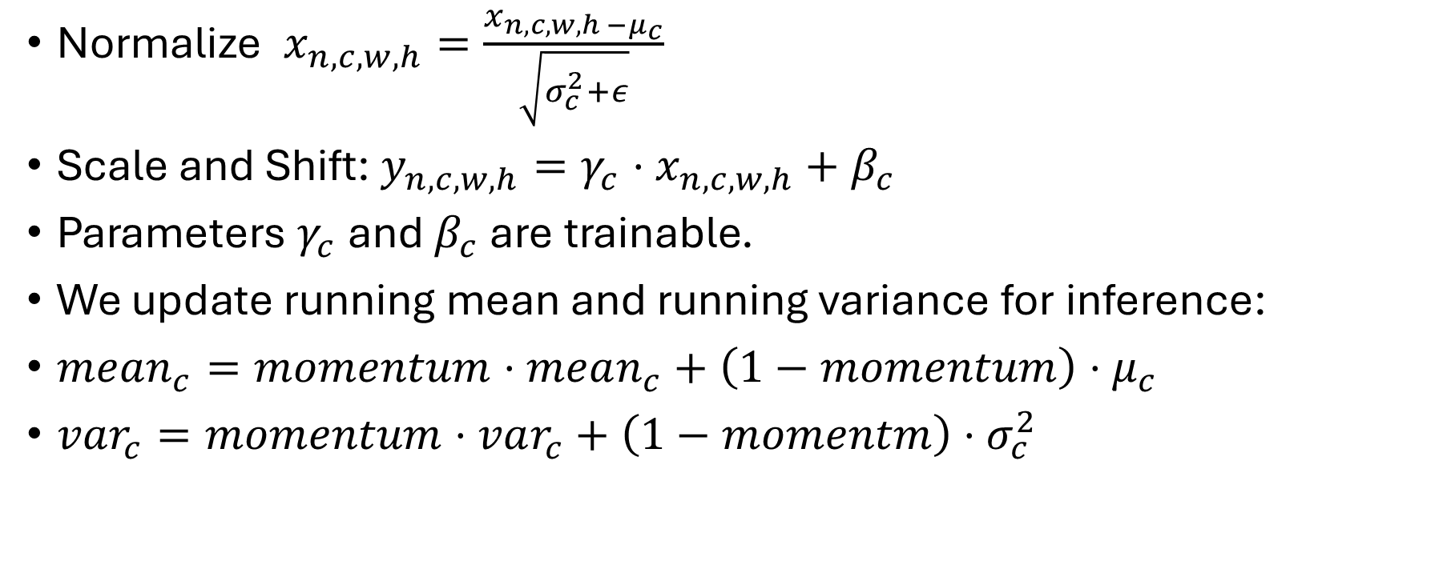
Batch Normalization - Training
Normalize $x_{n,c,w,h}=\frac{x_{n,c,w,h −μ_{c}}}{\sqrt{σ_{c}^{2}+ε}}$
Scale and Shift: $y_{n,c,w,h}=γ_{c}⋅x_{n,c,w,h}+β_{c}$
Parameters $γ_{c}$ and $β_{c}$ are trainable.
We update running mean and running variance for inference:
$mean_{c}=momentum⋅mean_{c}+\left(1−momentum\right)⋅μ_{c}$
$var_{c}=momentum⋅var_{c}+\left(1−momentm\right)⋅σ_{c}^{2}$​

Slide 5
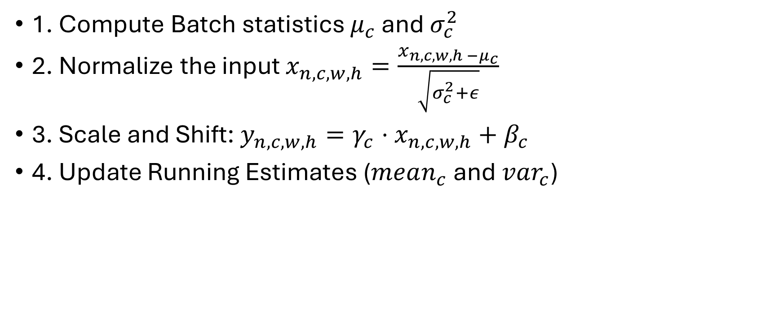
Batch Noramlization - Training
1. Compute Batch statistics $μ_{c}$ and $σ_{c}^{2}$
2. Normalize the input $x_{n,c,w,h}=\frac{x_{n,c,w,h −μ_{c}}}{\sqrt{σ_{c}^{2}+ε}}$
3. Scale and Shift: $y_{n,c,w,h}=γ_{c}⋅x_{n,c,w,h}+β_{c}$
4. Update Running Estimates ($mean_{c}$ and $var_{c}$)

Slide 6
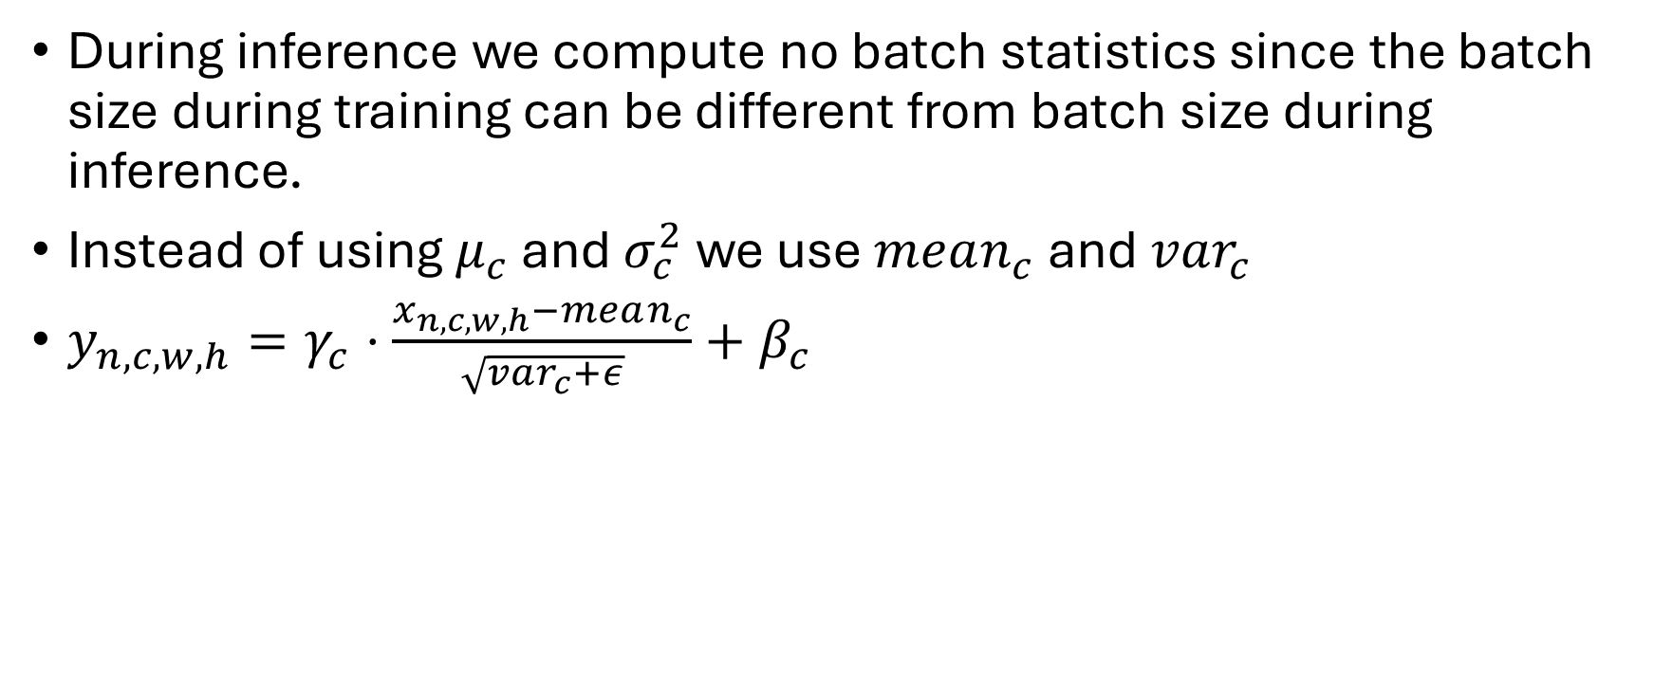
Batch Normalization - Inference
During inference we compute no batch statistics since the batch size during training can be different from batch size during inference.
Instead of using $μ_{c}$ and $σ_{c}^{2}$ we use $mean_{c}$ and $var_{c}$
$y_{n,c,w,h}=γ_{c}⋅\frac{x_{n,c,w,h}−mean_{c}}{\sqrt{var_{c}+ε}}+β_{c}$

Slide 7
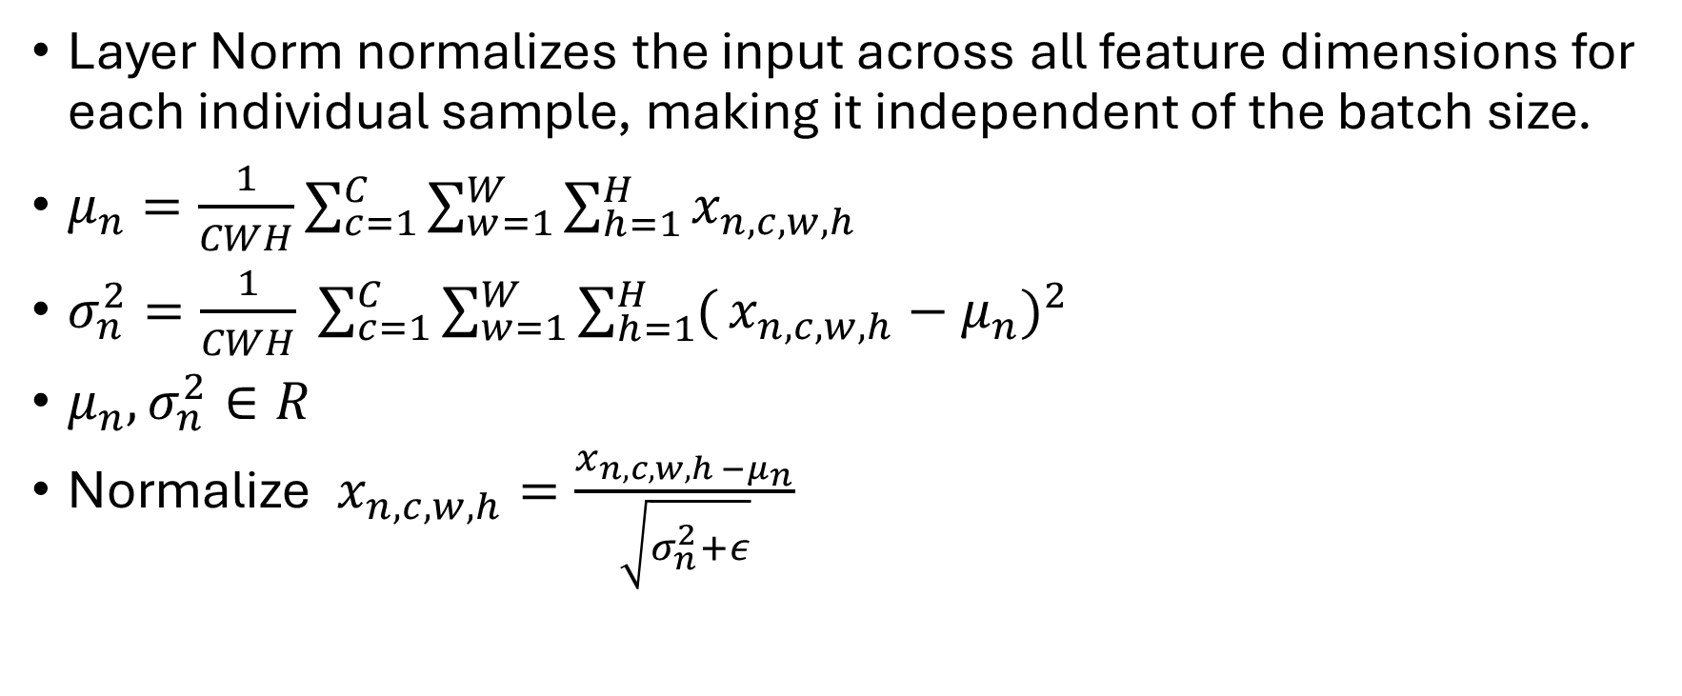
Layer Normalization
Layer Norm normalizes the input across all feature dimensions for each individual sample, making it independent of the batch size.
$μ_{n}=\frac{1}{CWH}\sum_{c=1}^{C}{\sum_{w=1}^{W}{\sum_{h=1}^{H}{x_{n,c,w,h}}}}$
$σ_{n}^{2}=\frac{1}{CWH} \sum_{c=1}^{C}{\sum_{w=1}^{W}{\sum_{h=1}^{H}{(}}}{x_{n,c,w,h}−μ_{n})}^{2}$
$μ_{n}, σ_{n}^{2}∈R$
Normalize $x_{n,c,w,h}=\frac{x_{n,c,w,h −μ_{n}}}{\sqrt{σ_{n}^{2}+ε}}$

Slide 8
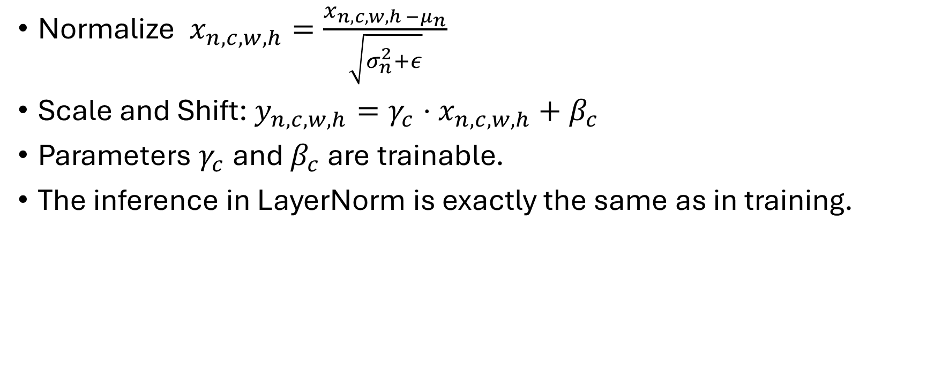
Layer Normalization
Normalize $x_{n,c,w,h}=\frac{x_{n,c,w,h −μ_{n}}}{\sqrt{σ_{n}^{2}+ε}}$
Scale and Shift: $y_{n,c,w,h}=γ_{c}⋅x_{n,c,w,h}+β_{c}$
Parameters $γ_{c}$ and $β_{c}$ are trainable.
The inference in LayerNorm is exactly the same as in training.

Slide 9
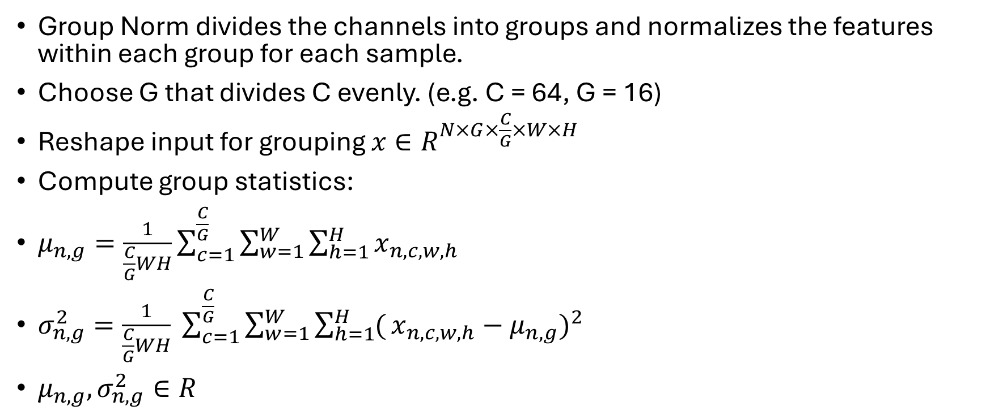
Group Normalization
Group Norm divides the channels into groups and normalizes the features within each group for each sample.
Choose G that divides C evenly. (e.g. C = 64, G = 16)
Reshape input for grouping $x∈R^{N×G×\frac{C}{G}×W×H}$
Compute group statistics:
$μ_{n,g}=\frac{1}{\frac{C}{G}WH}\sum_{c=1}^{\frac{C}{G}}{\sum_{w=1}^{W}{\sum_{h=1}^{H}{x_{n,c,w,h}}}}$
$σ_{n,g}^{2}=\frac{1}{\frac{C}{G}WH} \sum_{c=1}^{\frac{C}{G}}{\sum_{w=1}^{W}{\sum_{h=1}^{H}{(}}}{x_{n,c,w,h}−μ_{n, g})}^{2}$
$μ_{n,g}, σ_{n,g}^{2}∈R$

Slide 10
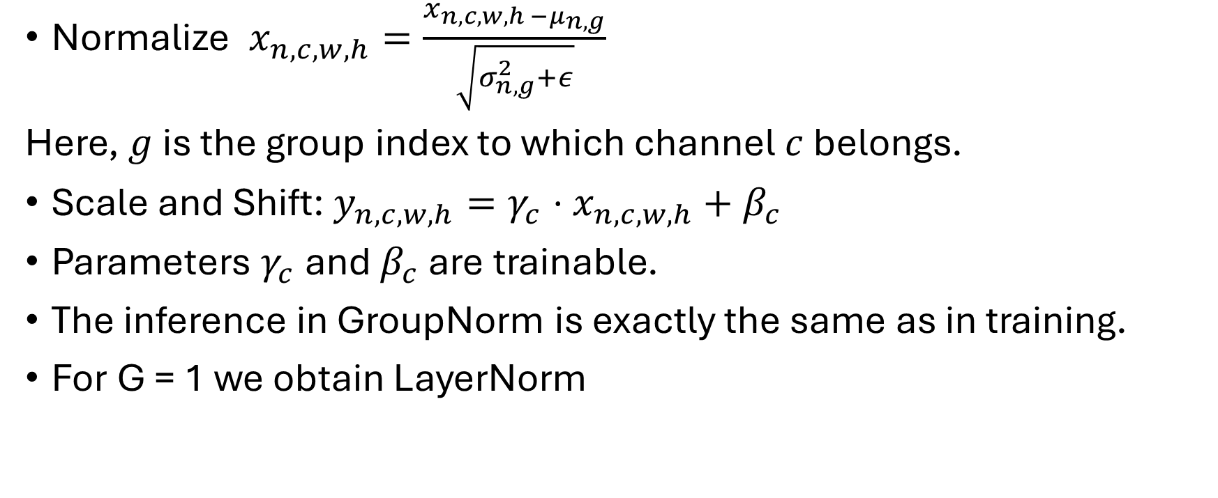
Group Normalization
Normalize $x_{n,c,w,h}=\frac{x_{n,c,w,h −μ_{n, g}}}{\sqrt{σ_{n, g}^{2}+ε}}$
Here, $g$ is the group index to which channel $c$ belongs.
Scale and Shift: $y_{n,c,w,h}=γ_{c}⋅x_{n,c,w,h}+β_{c}$
Parameters $γ_{c}$ and $β_{c}$ are trainable.
The inference in GroupNorm is exactly the same as in training.
For G = 1 we obtain LayerNorm

Slide 11
Thank you for your attention

